Slide 1
Network Security Project
CREATING A VIRTUAL NETWORK USING ORACLE VIRTUALBOX
BY: Y@h@ck5 +2348140879281

Slide 2
Why Virtual Newtwork?
Virtual network is needed in this project in other to carry out the test cases in a secure an monitored enviroment as virtual machines used maybe vulnerable.
To set up a virtual network I will be setting that up on my Windows 10 OS using a Oracle VirtualBox.
In the VirtualBox I will be setting up two machines one as a server(Metasploitable2) and the other client(Kali Linux).
I will also be setting up the server to have a static IP address.

Slide 3
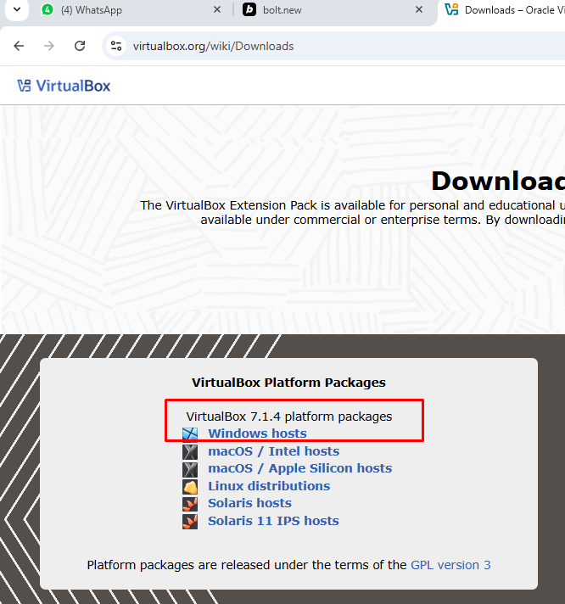
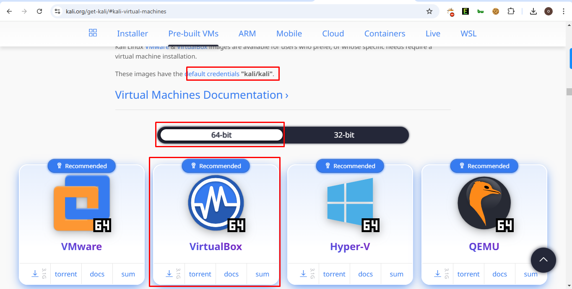
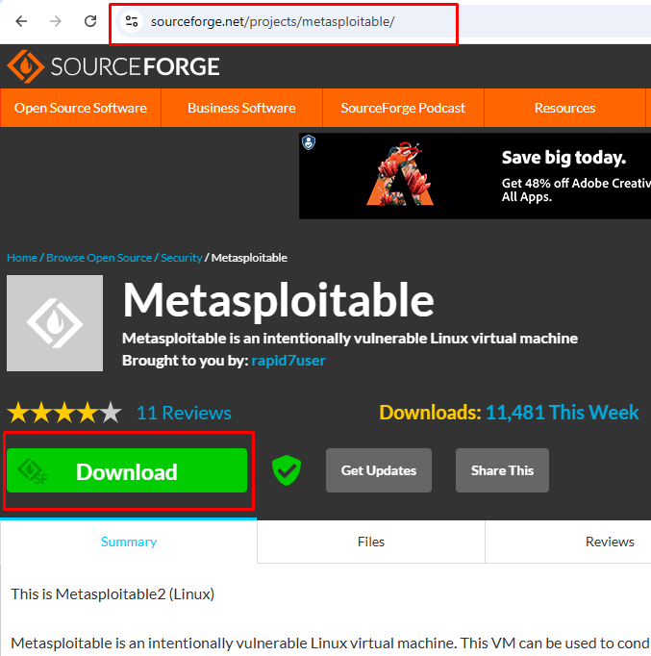
Downloading the Tools/Machines
First we need to download the Oracle VM from its website and other virtual machines as seen in the image. Link in the image.

Slide 4
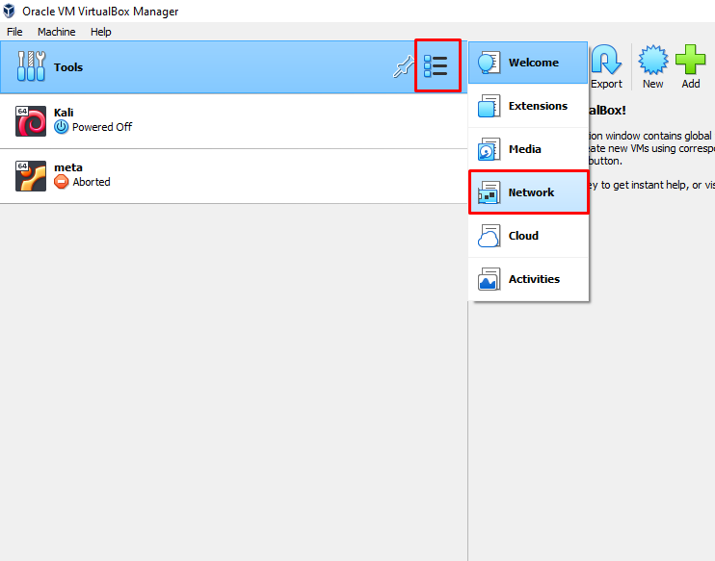
Creating Host-only Virtual Netwok
After downloading our Virtual machines and VirtualBox we can proceed to installing the Oracle VM. The installation process can been found over the internet.
Next we can further create a Host only virtual network by clicking on the Tools in the VirtualBox window as seen in the image.

Slide 5
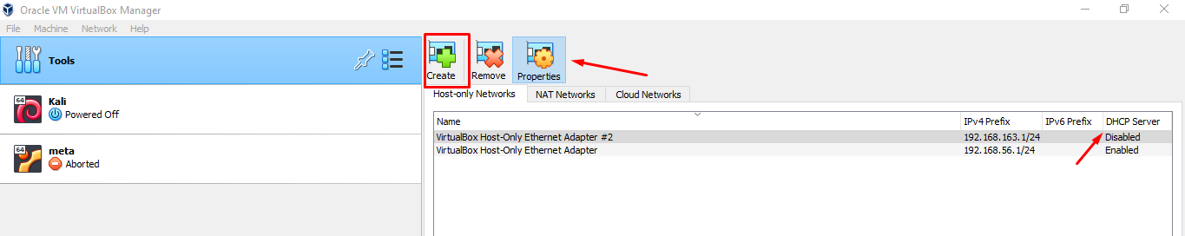
Create and Change DHCP setting
Click Create to create a new Host-only network. This means both virtual machines will not have internet connection. except for the host machine(Windows OS). Click Properties to the DHCP server.

Slide 6
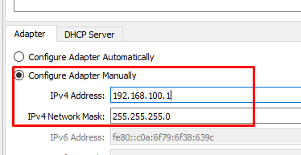
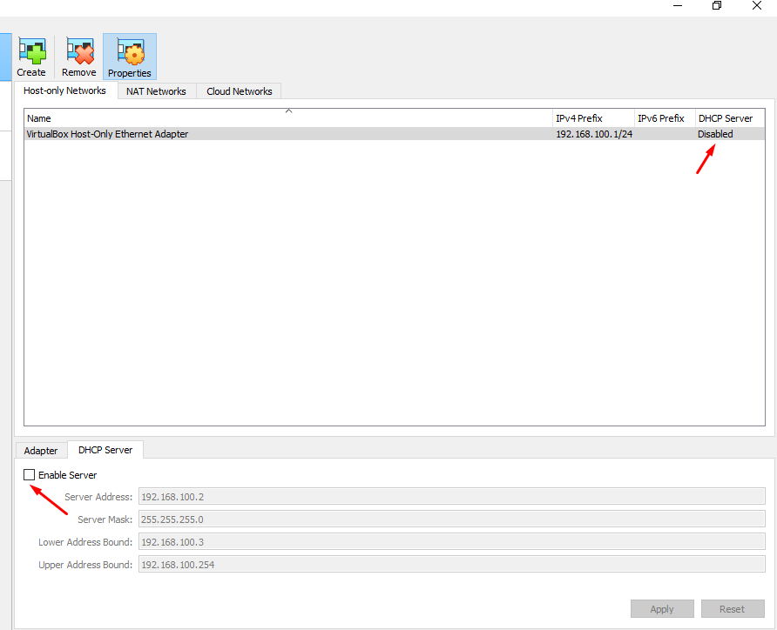
Configure Adapter Manually
In the Adapter Tab after clicking on properties set the radio button to Configure Adapter Manually. This is so, so that we can set our desired IP for the virtual network.
In the DHCP Tab I unchecked the box close to DHCP, this diabled dhcp allowing me to assign a static IP to the server machine(Metasploitable2).

Slide 7
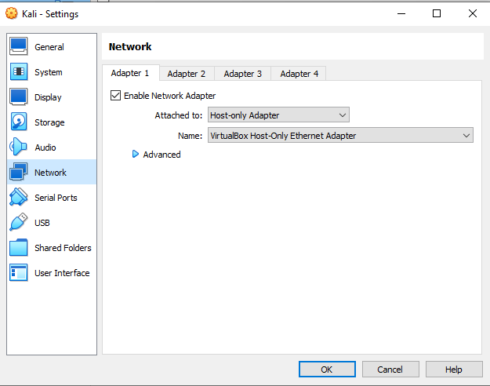
Set each Machine to Host-only Network
Once the Host only network has been created, I need to set each machine in the VM to use that network. Click Network settings for each machine and select Host-only.

Slide 8
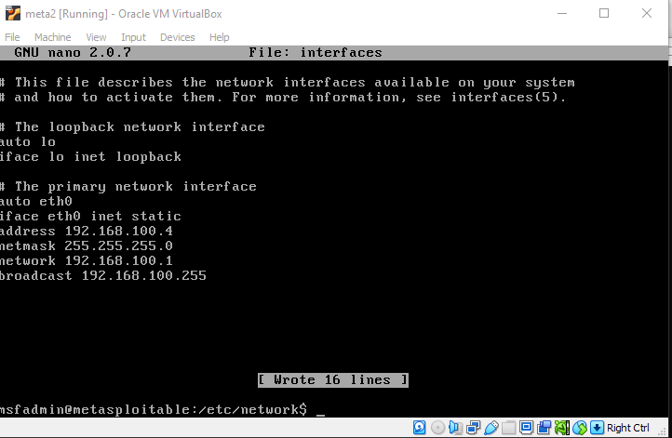
Setting Static IP Address for Server
In other to set up a static IP address for my server machine(Metasploitable2).
Edit the /etc/network/interfaces file in the OS as seen in the image. IP address set to 192.168.100.4

Slide 9
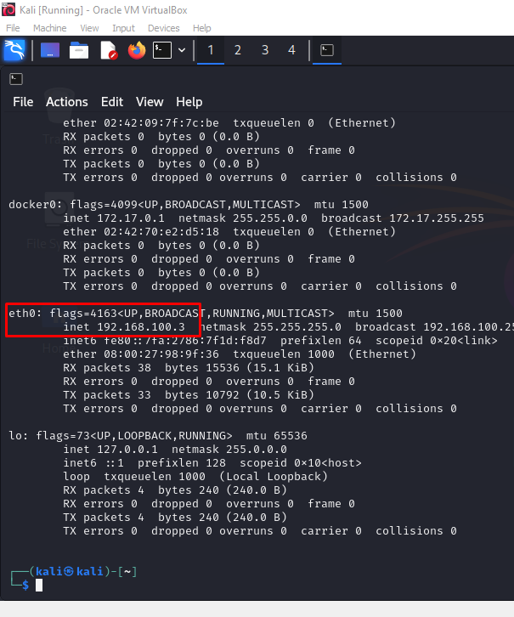
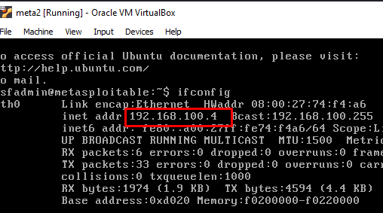
Confirm The IP Address for Machines
Restart the Server Once the Static IP have been set. On boot, navigate to the terminal and type ifconfig to confirm the IP address. Do the same for our client(Kali) machine. Confirm IPs as seen in the images

Slide 10
THANKS
NEXT: IDENTIFYING VULNERABILITIES

